Slide 1
Students’ teamwork in informatics courses at faculty of sciences in novi sad
Natalija Ivanović, student, Faculty of Sciences, University of Novi Sad

Slide 2
Agenda
Introduction
Courses and assignments
Personal Experience
Conclusions

Slide 3
1. Introduction
Overview of students’ teamwork in informatics courses at Faculty of Science, University of Novi Sad, Serbia.
Teamwork is very important for future job in IT companies
Good teamwork requires:
A good leader
A good plan to carry out assignments
More or less equal involvement of all members
A good cooperation and communication between
team members
A lot of patience and tolerance
Finishing tasks on time

Slide 4
1. Introduction
Unfortunately usually we can not choose our collaborators
There is a big chance that at least one of your team members will be:
Lazy
Impatient
Uninterested
Irresponsible...
Teamwork experience during studies is very important for future jobs
Professors within different courses prepare us for different situations

Slide 5
Agenda
Introduction
Courses and assignments
Personal Experience
Conclusions

Slide 6
2. Courses and assignments
Introduction to e-Business
Object Oriented Programming II
Software Engineering
Information Systems

Slide 7
2.1. Introduction to e-Business
First experience with teamwork was in the first year of studies
“Introduction to e-Business” course was a great way to introduce students with teamwork
Teams consisted of 3-5 members
Grading
Three online tests
Four teamwork assignments

Slide 8
2.1. Introduction to e-Business Assignments
Online business model
An imaginary e-Commerce company/organization
In a wiki form
e-Commerce Web site
Putting the business model into practice
Building a Magento e-Store
Marketing tools and promotions
Improving the e-Store
Pricing rules, customer groups, polls, newsletters, etc.
Business blog
Creating a business blog in WordPress

Slide 9
2.2. Object Oriented Programming II
Elective course in the second year of studies
Advanced OOP
Teams of 3 members selected based on points
Grading
Four tests
Two teamwork assignments

Slide 10
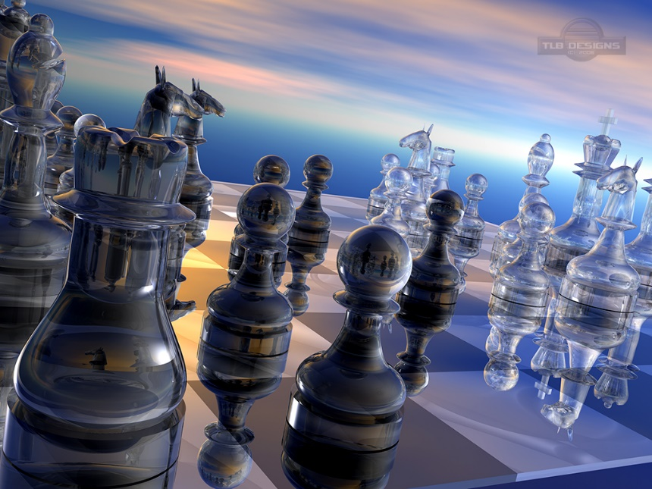
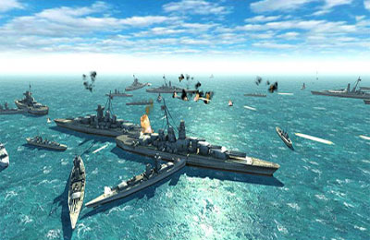
2.2. Object Oriented Programming II Assignments
Making games
Chess
Battleship

Slide 11
2.3. Software Engineering
Course in the third year of studies
Teams of 4 members randomly selected
Grading
Four tests
Six teamwork assignments
Requires a lot of time
Assignments were solved collaboratively in Wiki

Slide 12
2.3. Software Engineering Assignments
Review the requirements document for ‘Seminar organization’ case study
Apply FP method to ‘Seminar organization’
Review product model (structured analysis) of ‘Seminar organization’
Derive use case diagram and class diagram from problem description
Develop formal specification for Queue, improve and modify given Z specification
Software metrics

Slide 13
2.4. Information Systems
Course in the third year of studies
Teams of 2 or 3 members
Students created teams on their own
No tests, just one assignment
Creating particular information system

Slide 14
2.4. Information Systems Assignments
Information system for high school
We made diagrams with Papyrus plugin
Use-case diagram
Class diagram
Boundary and control classes
Sequence diagram
Component diagram
Relational model was made in PowerDesigner
Also we had to make a graphical user interface

Slide 15
Agenda
Introduction
Courses and assignments
Personal Experience
Conclusions

Slide 16
3. Personal Experience
Introduction to e-Business
Team consisted of two female and two male members
Our business model- Antique shop
One lazy member
One uninterested member
The two of us did the most of the work
We never had meetings, we communicated using Facebook, Skype or Moodle

Slide 17
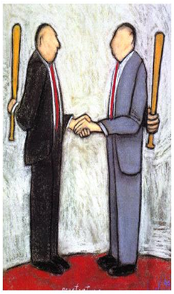
3. Personal Experience
Object Oriented Programming II
I was in team with two males
The worst experience
One of members was lazy and the other was stubborn and bossy
First assignment was quite successful (although we had a lot of disagreements and problems)
The second assignment was a disaster
It was very difficult to make a battleship game

Slide 18
3. Personal Experience
Object Oriented Programming II
A lot of new and complicated things
And then the lazy one decided to go on a vacation
So it was impossible for two of us to finish this assignment in time
We never had meetings, we used Facebook and Moodle to communicate
We used SVN to make project available on everyone's computer

Slide 19
3. Personal Experience
Software Engineering
I was in a team with three more males
This was a pretty good team, except one of them was lazy and uninterested
He had a friend in the team so that friend did the job for him
But it did not affect our work
Everything else was great
Good leader, finishing tasks on time, good communication and collaboration…

Slide 20
3. Personal Experience
Information Systems
The best teamwork so far
I was with two friends in a team and we equally shared the job
We all wanted a good grade (motivation is important factor)
Each of us do there part of the job and then we meet and put it all together
We had about 3 to 4 meetings
It was a pleasure working with them

Slide 21
3. Personal Experience
The thing that was common for all my teams
LAST MINUTE WORK

Slide 22
Agenda
Introduction
Courses and assignments
Personal Experience
Conclusions

Slide 23
4. Conclusions
Teamwork is very important for ICT jobs
Students collected significant experiences working in teams within different courses during study
We had chance to learn how to cooperate and collaborate with different colleagues and different teams
We had chance to learn how to cope with wide range of disputes and unpleasant situations
Good experience for our future professional life and jobs

Slide 24
Thank you for your atention!

